Slide 1
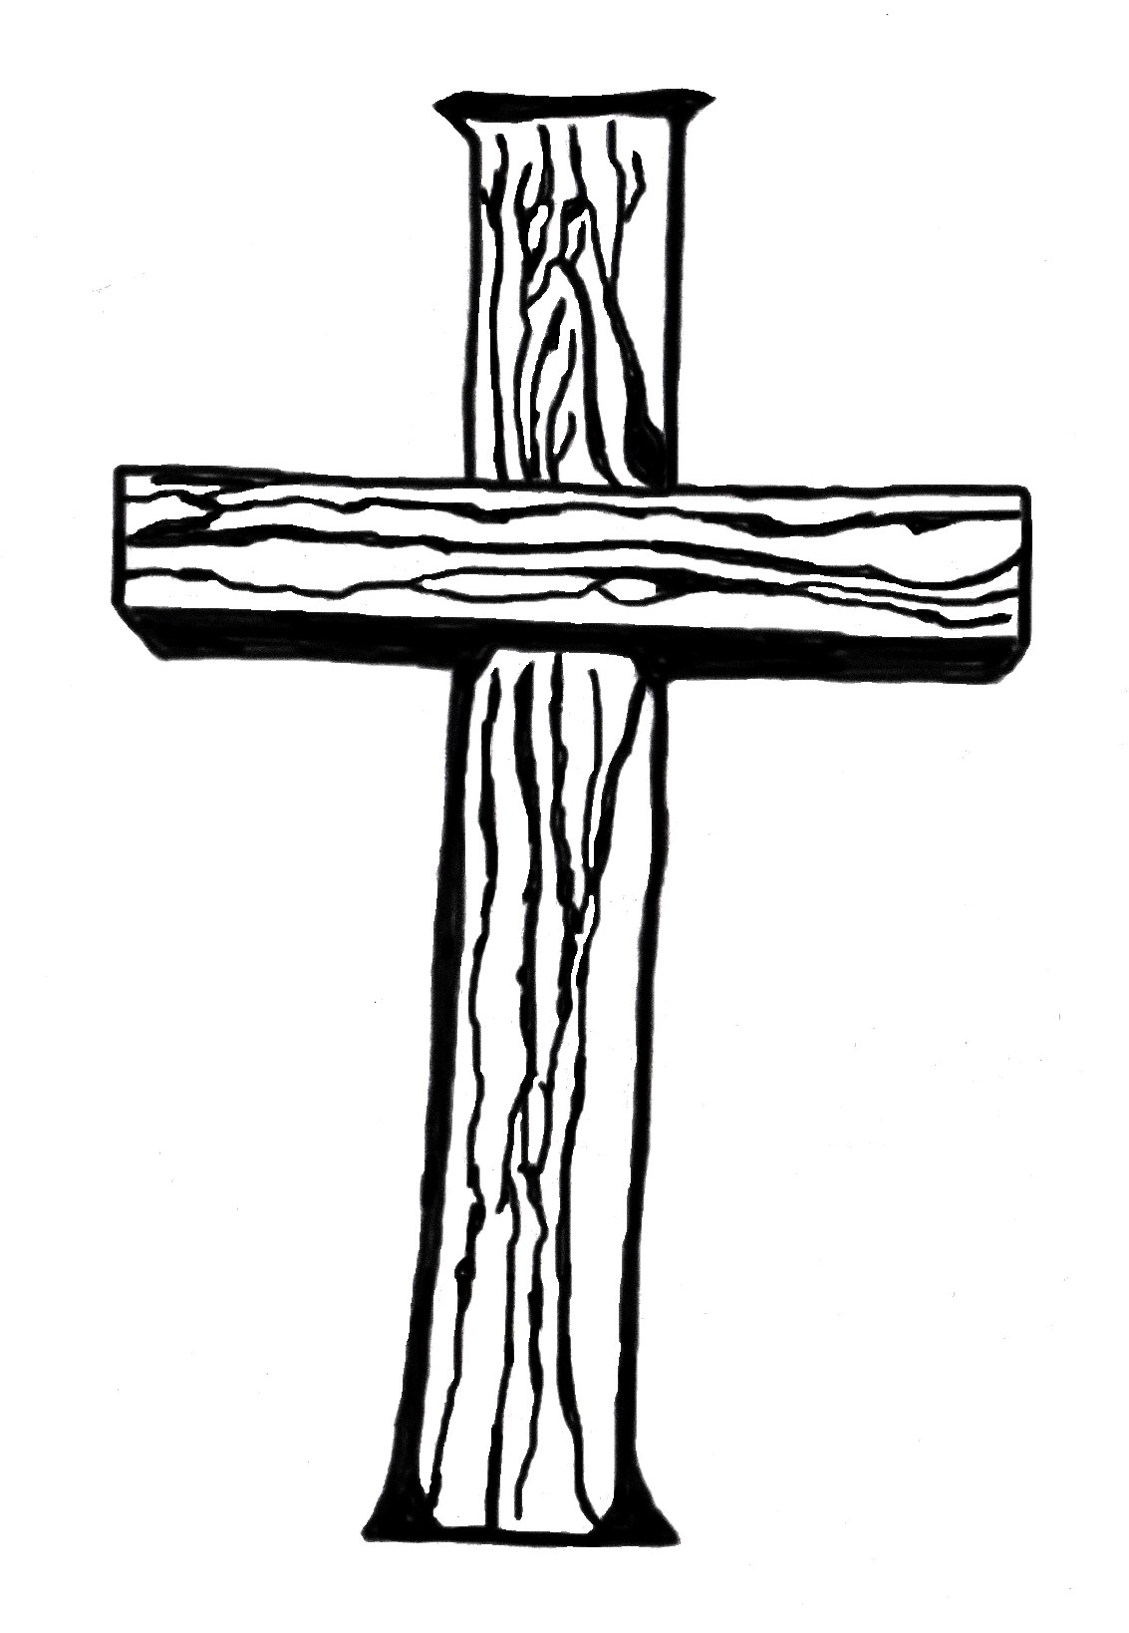
New Testamen Church
Principles of the
Chapter 3
Characteristics of the New Testament Church

Slide 2
The Church in the New Testament
Scripture Text: Acts 2:37-47
Church in the New Testament means:
Pattern was revealed to the apostles
Acts 1:1-5
Organization came directly from Christ and was set up by the apostles
Church was organized PRIOR to human creeds and practices

Slide 3
The Church in the New Testament
Church in the New Testament means:
The “one body” is vitalized by “one Spirit”;
Animated by “one hope”;
Acknowledging the “one Lord”;
Professing the “one faith”;
Submissive to the “one baptism”;
Humbly dependent upon the “one God and Father of all”
Ephesians 4:4-6

Slide 4
The Church in the New Testament
As to the ORIGIN
When was the church established?
Isaiah 2:2-4
Matthew 3:2, 13-17
Matthew 10:5-7
Luke 10:8-9
Matthew 18:15-17
Matthew 16:13-19
Luke 24:46-49
Acts 1:1-5

Slide 5
The Church in the New Testament
Covenant
Not binding until death
Testament
Not in operation as long as testator lives
Kingdom
Not established until king ascended and was crowned
Church
Not organized while Jesus was on earth
Great Salvation (Hebrews 2:3)
Not proclaimed until the apostles proclaimed it

Slide 6
The Church in the New Testament
Christ could not have consistently claimed all authority in heaven and upon earth until He conquered death. It was necessary for Him to suffer and die and to arise from the dead before repentance and remission of sins could be preached in His name. The facts of the gospel, on which the church was founded, could not have been preached until it actually transpired. The facts of the gospel are the death, burial and resurrection of Christ (I Corinthians 15:1-4). These were publicly proclaimed as facts for the first time in the history of the world on Pentecost, A.D. 30, the first Pentecost after His resurrection.
CC Crawford, Sermon Outlines on the Restoration Plea (Murfreesboro: Dehoff Publications, 1956), 11.

Slide 7
The Church in the New Testament
As to the TERMS OF ADMISSION
Faith in Christ as the Son of God
Acts 16:31; Romans 10:9-10
Repentance toward Christ
Acts 2:38; Luke 13:3; Acts 17:10; II Corinthians 7:10
Confession of Christ
Matthew 10:32-33
Made with the mouth – Romans 10:9-10
In the presence of witnesses – II Timothy 6:12

Slide 8
The Church in the New Testament
As to the TERMS OF ADMISSION
Baptism into Christ
Matthew 28:19-20; Mark 16:16; Acts 2:38
Burial – Romans 6:3-5; Colossians 2:12
Penitent believer – Mark 16:16; Acts 2:38, 18:8
In water – John 3:23; Acts 8:36-39, 10:47
Unto the remission of sins – Acts 2:38, 22:16; Mark 16:16; John 3:5; I Peter 3:21

Slide 9
The Church in the New Testament
As to the NATURE
Church was visible – Galatians 1:13
Church was invisible – I Peter 2:5
While it was the “general assembly and church of the first-born who are enrolled in heaven” (Hebrews 12:23), yet its members assembled for public worship in visible organizations known as “churches of Christ” (Romans 16:16).
CC Crawford, Sermon Outlines on the Restoration Plea (Murfreesboro: Dehoff Publications, 1956), 12.

Slide 10
The Church in the New Testament
As to the FOUNDER AND FOUNDATION
Founder is Christ
Matthew 16:18
Head is Christ
Ephesians 1:22-23

Slide 11
The Church in the New Testament
As to the FOUNDER AND FOUNDATION
Foundation is an eternal truth
Jesus is the Christ, the Son of the Living God
Jesus is the TRUTH, so the church is built on Jesus
I Corinthians 3:11
Ephesian 2:19-20

Slide 12
The Church in the New Testament
As to the NAME
Universal Organization or church catholic
Known as the church
Colossians 1:18
The body of Christ
Colossians 1:24; Ephesians 4:12; I Corinthians 12:27
The church of God
I Corinthians 15:9; I Timothy 3:5

Slide 13
The Church in the New Testament
As to the NAME
Local congregations of the saints
Churches
I Corinthians 16:1-2; II Corinthians 8:1
Churches of God
I Thessalonians 2:14; I Corinthians 1:2
Churches of Christ
Romans 16:16

Slide 14
The Church in the New Testament
As to the NAME
Individual members
Disciples – Acts 11:26, 19:30
Brethren – I Corinthians 15:6; James 1:2; I Peter 1:10
Priests – I Peter 2:9; Revelation 5:10
Christians – Acts 11:26, 26:28; I Peter 4:16

Slide 15
The Church in the New Testament
As to the CREED
Latin word “credo” means “I believe”
The creed of the early church was Christ Himself
Belief in the person – Jesus as the Christ, the Son of the living God
Paul said “I know Him whom I have believed” (not what) – II Timothy 1:12
The Creed DOES NOT change! (Hebrews 13:8)

Slide 16
The Church in the New Testament
CREED – Jesus is the Christ, the Son of the Living God
Simple
Profound
Comprehensive
Divine
A pattern
Capable of bringing out the best in our lives
Universal
Perfect
CC Crawford, Sermon Outlines on the Restoration Plea (Murfreesboro: Dehoff Publications, 1956), 14.

Slide 17
The Church in the New Testament
As to the Discipline
Discipline of the church was the apostles’ doctrine
At first it was oral
Later compiled in written form
Handed down in the New Testament canon
Teachings of Christ, as revealed by the Holy Spirit
John 14:26, 16:13-15, 20:22-23; Acts 2:4
The New Testament has always been, and always will be, a sufficient guide in religious faith and practice.
CC Crawford, Sermon Outlines on the Restoration Plea (Murfreesboro: Dehoff Publications, 1956), 14.

Slide 18
The Church in the New Testament
As to the Worship
The members assembled in local congregations on each first day of the week
Acts 20:7; I Corinthians 11:18-22; Hebrews 10:25
Remembered the resurrection – Mark 16:9
Called the “Lord’s Day” – Revelation 1:10

Slide 19
The Church in the New Testament
As to the Worship
The early church continued steadfast in four things
Apostles’ teaching
Fellowship
The breaking of bread
Prayer

Slide 20
The Church in the New Testament
As to the Organization
Temporary functions
Apostles
Prophets
When the word was completed, and upon their deaths, these functions were replaced.

Slide 21
The Church in the New Testament
As to the Organization
Permanent functions
Evangelists – Acts 21:8; Ephesians 4:11; II Timothy 4:5
Elders – Titus 1:5-9; I Timothy 3:1-7; Acts 20:28
Overseers, shepherds, elders and teachers
Deacons – Acts 6:1-6; I Timothy 3:8-13

Slide 22
The Church in the New Testament
As to the Mission
To preserve the truth of God
I Timothy 3:15; II Timothy 2:2
To proclaim this truth
Matthew 28:19; Mark 16:15
All the aims and duties of the church may be comprehended in these two basic works. When the church neglects either, she is failing just to that extent in accomplishing the purposes of Christ in the world.
CC Crawford, Sermon Outlines on the Restoration Plea (Murfreesboro: Dehoff Publications, 1956), 16.

Slide 23
The Church in the New Testament
As to the Unity
The church was originally one body – Ephesians 4:4-6
Ephesians 4:4-6
John 17:20-21
Amid the multiplicity of “churches” in modern times, is it possible to find and identify this New Testament church?

Slide 24
The Church in the New Testament
To find a New Testament church, ask these questions
What church has no creed but Christ?
What church has no book of discipline but the New Testament?
What church requires the same terms of admission as did the New Testament church?
What people wear the same religious designations as those worn in the New Testament times, preferring to be called Christians only?

Slide 25
The Church in the New Testament
To find a New Testament church, ask these questions
What church has no other functions in the church but evangelists, elders and deacons?
What church insists that the ordinances be obeyed as they were in the New Testament?
What church meets each first day of the week for the apostles’ teaching, fellowship, the breaking of bread, and prayer?
What church possesses all the earmarks of the New Testament church?

Slide 26
The Church in the New Testament
Whenever you find a body of people practicing these things, there you find a church after the New Testament pattern. Paul says to “prove all things; hold fast that which is good” (I Thessalonians 5:21). We invite you to unite with us now on the Bible and the Bible alone.
CC Crawford, Sermon Outlines on the Restoration Plea (Murfreesboro: Dehoff Publications, 1956), 18.

