Slide 1
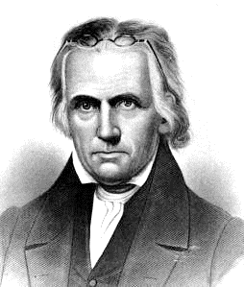
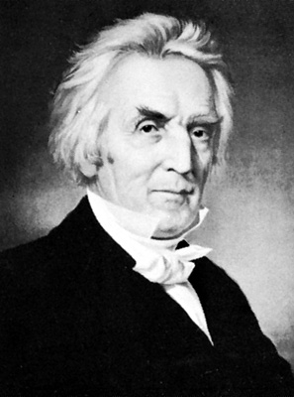
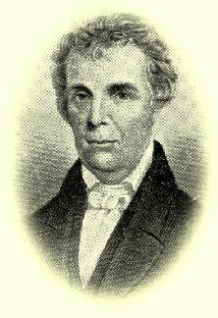
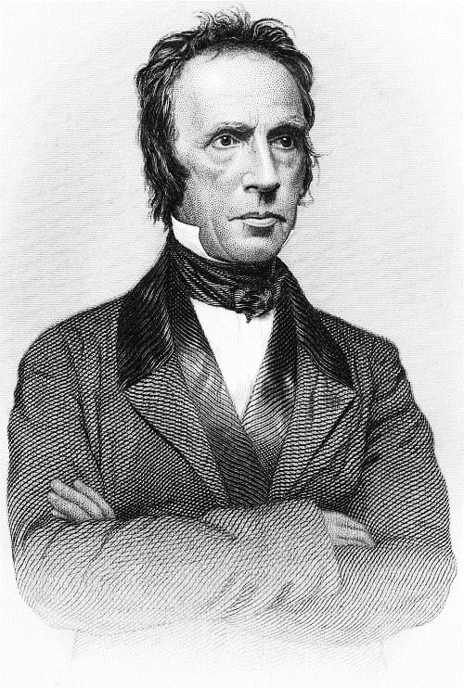
History of the Restoration Movement a study of the restoration ideal Lesson 10 Racoon John Smith The Frontier Evangelist
Kevin L. Ziegler, evangelist
South Side Church of Christ, Danville, IL
Restoration Plea Ministries

Slide 2
Outline of Class
Lesson 1 – What is meant by “Restoration Movement” and Why it Needs to be Taught
Lesson 2 – “Restoration” as a Biblical Principle
Lesson 3 – Restoration Movement before America
Lesson 4 – What made America Ready for the Restoration Movement?
Lesson 5 – Early Attempts at Restoration in America
Lesson 6 – Barton W. Stone – Consistent with the Word of God
Lesson 7 – Thomas Campbell – Speaking Where Scriptures Speak
Lesson 8 – Alexander Campbell – the Ancient Order of Things
Lesson 9 – Walter Scott – the Gospel Restored
Lesson 10 – Racoon John Smith – the Frontier Evangelist
Lesson 11 – Divisions within the Church
Lesson 12 – The Restoration Ideal in Today’s Church

Slide 3
Racoon John Smith – the Frontier Evangelist
Racoon John Smith – Early Life
Racoon John Smith was born in 1784
In 1795 Smith's father moved his large family from Sullivan County, Tennessee to Stockton's Valley, Kentucky.
It was sparsely-settled frontier woods. The area in which they lived soon came to be populated by stern, hardy, Baptist (mostly) neighbors.
John was a true son of the frontier. Skilled at farming and hunting, accustomed to the hard, limited, and dangerous life of the frontier.
John had a keen mind and a highly-retentive memory. He desperately wanted to learn. He managed to receive about 4 months of schooling from an itinerant preacher. He learned little more than how to read.

Slide 4
Racoon John Smith – the Frontier Evangelist
Racoon John Smith – Religious background
John was raised in strict Calvinism.
Smith was told by his mother to “wait on the Lord.” He would go into the forest and cry for salvation.
December 26, 1804, he reported his struggles to the Baptist church and was voted in.

Slide 5
Racoon John Smith – the Frontier Evangelist
Racoon John Smith – the preacher
Smith claimed no call to the ministry, but had a strong desire to preach.
He agreed to make a talk. He panicked, his memory failed him, and he ran out into the darkness and fell down praying. His memory returned, and he went back in to thrill the audience with his message.
May 1808 – He was ordained and the same day baptized 4 people.
His voice was deep and rich, his utterances deliberate and distinct. Sermons in those days were delivered in the preacher-chant. Some claimed that Smith could be heard as far away as 2 miles.
John studied the English Bible diligently. Late at night and at noon in the fields. At the dinner hour he ate with the Bible open before him as he memorized scores of verses.

Slide 6
Racoon John Smith – the Frontier Evangelist
Racoon John Smith – Family Life
1806 Smith secured 200 acres and married Anna Townsend.
They built and moved into a log cabin with no doors or windows and a dirt floor.
1814 Smith moved his family to Huntsville, AL
While Smith was away, his wife was called to sit with a sick neighbor. While she was gone, the cabin burned, and two of their eight children were burned to death.
Anna refused to be comforted and blamed herself. Two months later she died and was buried with the remains of her two children.

Slide 7
Racoon John Smith – the Frontier Evangelist
Racoon John Smith – Family Life
Smith found that the doctrine of reprobation prevented his either feeling or giving comfort concerning his dead children.
Smith became sick after his wife died and was near death for 3 months. The whole experience, enhanced by his naturally rational and questioning mind, caused Smith to rethink the Calvinism that he was preaching.

Slide 8
Racoon John Smith – the Frontier Evangelist
Racoon John Smith – Return to Kentucky
Smith returned a broken man, convinced that his terrible troubles were a punishment from the Lord because he had desired to increase his worldly possessions.
He became popular in Kentucky and resumed his farming-preaching life.
He married Nancy Hurt and once again he had a stable family situation.
He continued to question the truth of Calvinism.

Slide 9
Racoon John Smith – the Frontier Evangelist
Racoon John Smith – Return to Kentucky
In 1822 he was preaching at Spencer's Creek urging sinners to repent and believe the Gospel. “Jesus died for you,” said he; “but if you believe not, you must be damned.”
His mind was suddenly confused with the thought that, if the elect should not believe, his preaching was false, for they would not be damned; and, if the non-elect should believe, their faith would be false, for, according to his creed, Christ did not die for them. Must the non-elect, then, thought he, be damned or not believing what is false? Or the elect be saved through denying the truth? Too honest thus to exhort the people any longer, he closed his address. “Brethren,” said he, “something is wrong. I am in the dark. We are all in the dark; but how to lead you to the light, or to find the way myself, before God, I know not.”

Slide 10
Racoon John Smith – the Frontier Evangelist
Racoon John Smith – Return to Kentucky
Smith returned home and promised his wife that he “would take God's Word as his only oracle, examine it carefully, and, calling no man master, follow its teachings, wherever they might lead him.”

Slide 11
Racoon John Smith – the Frontier Evangelist
Racoon John Smith – the Reformer
1824 – Smith met Alexander Campbell in Flemingsburg, KY.
Campbell was to come to Mt. Sterling, so Smith went to meet him at Flemingsburg to hear him and to accompany him on the rest of his journey. He had read an article on “Experimental Religion” written by Campbell and was anxious to determine whether Campbell was to be received as a brother and believed.
By 1830, Smith had led a majority of the Baptists in Kentucky into the reform. Scores of congregations were established.

Slide 12
Racoon John Smith – the Frontier Evangelist
Racoon John Smith – New Emphasis in Preaching
No promise of salvation without immersion.
Baptism to be administered without further examination to those who have confessed faith in Christ.
Depending upon the Word, not the direct influence of the Holy Spirit to penetrate the heart of the alien sinner.
The Bible vs. creeds.
The freedom of any Christian to baptize.

Slide 13
Racoon John Smith – the Frontier Evangelist
Racoon John Smith – Character of his Preaching
Powerfully persuasive. Few preachers have ever been able to make a point stick as well as John Smith. After he had taught on a text, his listeners could remember the details of his sermon after 30 or 40 years.
He combined a remarkable memory, a quick wit, common sense, and a passion for the Word. He was Elijah-like in his unwillingness to compromise.
Ungainly in appearance. Smith did not dress well, even according to frontier standards.
Learned without formal education. Alexander Campbell said of Smith, “John Smith is the only man I have ever seen that a college education could ruin.”

Slide 14
Racoon John Smith – the Frontier Evangelist
Racoon John Smith – Character of his Preaching
Merciless humor.
When asked the difference between baptism and the mourners’ bench, he replied, "One is from heaven, the other is from the sawmill."
When asked if he was not embarrassed when preaching before lawyers and judges in Sparta, TN, Smith answered, “Not in the least; for I have learned that judges and lawyers, so far as the Bible is concerned, are the most ignorant class of people in the world, except Doctors of Divinity. I do confess that the first time I ever preached before Alexander Campbell; I did falter a little.”

Slide 15
Racoon John Smith – the Frontier Evangelist
Racoon John Smith – Character of his Preaching
Systematic presentation of the truth.
Smith’s sermons normally lasted 2-3 hours, and consisted of 3 parts:
Correction of misrepresentations. (The Restorationists were continually slandered and misrepresented.)
Expose doctrinal errors.
Present the Gospel of Christ.

Slide 16
Racoon John Smith – the Frontier Evangelist
Racoon John Smith – Break with the Baptists
Smith formally parted company with the Baptists when the association brought three charges against him.
He taught from the Living Oracles rather than the KJV.
When baptizing, he said “I immerse you” instead of “I baptize you”
He allowed members to break their own bread at the table instead if doing it for them as the presiding minister.

Slide 17
Racoon John Smith – the Frontier Evangelist
Racoon John Smith – Later Life
1832 – Further tragedies. While Smith was attending the Campbell-Rice debate in 1832, his youngest son Richard fell into a boiling kettle of water being prepared for slaughtering hogs. He lived only 8 hours, dying before Smith could get home.
1861 – His wife Nancy died in 1861.
Smith was in reasonably good health except for a palsy during the last 20 years of his life.
January 1868, attending a debate between a Christian and a Methodist, Smith caught a fever. He knew that he was dying and told his daughters that he had only one regret, that his sons-in-law were not Christians.

Slide 18
Racoon John Smith – the Frontier Evangelist
Racoon John Smith – Later Life
Smith's last words: “My prospects are entirely satisfactory. I have no fears, whatsoever, about the future. I am nearly home. What a great failure after all, would my long and checkered life have been, but for this glorious hope of a hereafter.”
February 28, 1868, Smith died in Missouri. His body was returned to Lexington. J.W. McGarvey assisted at the funeral.

