Slide 1
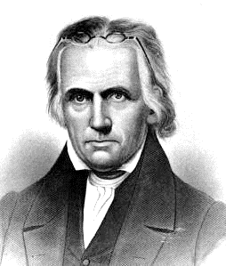
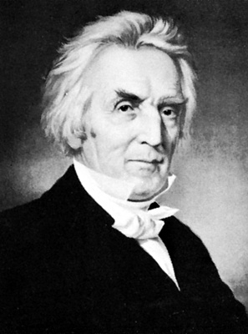
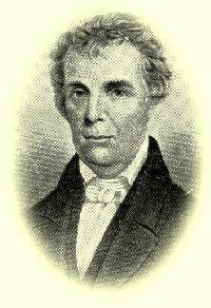
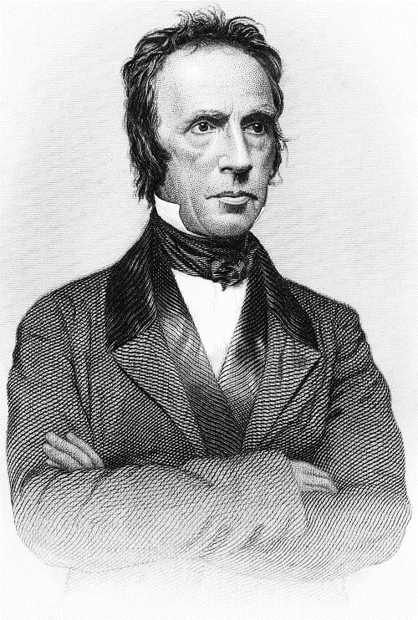
History of the Restoration Movement a study of the restoration ideal Lesson 9 Walter Scott The Gospel Restored
Kevin L. Ziegler, evangelist
South Side Church of Christ, Danville, IL
Restoration Plea Ministries

Slide 2
Outline of Class
Lesson 1 – What is meant by “Restoration Movement” and Why it Needs to be Taught
Lesson 2 – “Restoration” as a Biblical Principle
Lesson 3 – Restoration Movement before America
Lesson 4 – What made America Ready for the Restoration Movement?
Lesson 5 – Early Attempts at Restoration in America
Lesson 6 – Barton W. Stone – Consistent with the Word of God
Lesson 7 – Thomas Campbell – Speaking Where Scriptures Speak
Lesson 8 – Alexander Campbell – the Ancient Order of Things
Lesson 9 – Walter Scott – the Gospel Restored
Lesson 10 – Racoon John Smith – the Frontier Evangelist
Lesson 11 – Divisions within the Church
Lesson 12 – The Restoration Ideal in Today’s Church

Slide 3
Walter Scott – the Gospel Restored
Walter Scott – Early Life
October 31, 1796 - Scott was born in Moffatt, Scotland. One of ten children, his father a music teacher.
Walter was able to obtain a classical edu­cation at the University of Edinburgh.
A well-to-do uncle brought Walter to America.
For a year he taught Latin in an academy in Long Island, NY.

Slide 4
Walter Scott – the Gospel Restored
Walter Scott – Early Life
In 1819 he moved west to Pittsburgh, PA, where he became an instructor in a school conducted by George Forrester. Forrester was also the preacher of a small congregation which sprang up under the influence of the Haldanes and Sandeman, and which stood for the principle of “primitive Christianity”
They practiced foot-washing and the holy kiss, and immersion.
They were called the “Kissing Baptists”

Slide 5
Walter Scott – the Gospel Restored
Walter Scott – Religious Backgrounds
Reared in the Church of Scot land.
He was greatly impressed by Forrester's piety and became a member of his church.
Forrester withdrew from the congregation and later drowned, leaving Scott as head of the academy and preacher for the congregation.
Struggling with this new assignment, Scott used Forrester's library, reading avidly. He discovered a tract written by Henry Errett, father of Isaac Errett, a Scotch Baptist, an immersionist branch of the Sandemanians, on the subject of the purpose and effect of baptism. It introduced to Scott the idea that there was a connection between baptism and forgiveness or salvation.

Slide 6
Walter Scott – the Gospel Restored
Walter Scott – Religious Backgrounds
Scott journeyed to New York to learn more of the church group that had issued the tract. He found them to be ultra-sectarian and legalistic, and he returned to Pittsburgh disappointed.
Mr. Nathaniel Richardson, a wealthy Episcopalian, hired Scott as tutor of his son Robert (later to become a professor at Bethany College and Campbell's biographer)and some other boys. On his way back to Pittsburgh from New York, he visited several congregations of the Haldanean persuasion.

Slide 7
Walter Scott – the Gospel Restored
Walter Scott meets Alexander Campbell
Back in Pittsburgh, Scott resumed the ministry of the church and his class of boys grew to 140.
Scott continued to search the Scriptures. He came to the conviction that there should be no creed for the Church except “Jesus is the Christ.”
Scott and Campbell met in the winter of 1821-22, between the Walker and the MacCalla debates. They were congenial from the beginning.

Slide 8
Walter Scott – the Gospel Restored
Walter Scott meets Alexander Campbell
When they shared their thinking, it became obvious that they were in basic agreement, with Campbell emphasizing union and Scott emphasizing restoration.
Scott contributed a series of articles for Alexander Campbell’s Christian Baptist entitled: "A Divinely Authorized –Plan of Preaching the Christian Religion" in which he called for, among other things, faith as an intelligent act and an end to "mystical experience" salvation.
1826 – Scott moved to Steubenville, Ohio where he was nearer Campbell.

Slide 9
Walter Scott – the Gospel Restored
The spread of “Reformation” (especially eastern Ohio)
Local congregations were asking the Mahoning Association questions raised by the Reformers.
May a church that has no ordained elder observe communion or administer baptism.(The Association answered no.)
Is it apostolic for a church to have a confession of faith
and a constitution other than the Bible?
How were members received in the churches founded by the
Apostles?
Can associations find their model in the New Testament?
The church at Hiram voted to discard its church covenant, constitu­tion, and confession of faith, and to take the Bible alone.

Slide 10
Walter Scott – the Gospel Restored
Walter Scott and the Mahoning Association
August 1826 – Scott was invited to preach at the annual meeting
Alexander Campbell urged him to attend the following year also.
The Association included 17 congregations in 1827
Among the 14 that came to the annual meeting they reported 34 baptisms, 13 other additions, and 13 had been excommunicated
They decided that they needed an evangelist to revive the congregations
Walter Scott was nominated by the committee. (At this time he was not a Baptist. not ordained, and not living in the area served by the Mahoning Association.) Scott accepted.

Slide 11
Walter Scott – the Gospel Restored
Walter Scott the evangelist
Scott began in New Lisbon, Ohio.
His first convert was William Amend.
Baxter, Scott's biographer, made the following claim: He was "... the first person in modern times who received the ordinance of baptism in perfect accord with the apostolic teaching and usage.“ (Nov. 18, 1827)

Slide 12
Walter Scott – the Gospel Restored
Scott's approach to evangelism, according to Kershner:
He had never conducted a revival before and he had not apparently attended many such gatherings... It was lucky for him and the world that he knew so little about the business at hand. Had he known more, he might have gone on like the old emotionalists appealing to mass suggestions, inducing weak minded folk to bark like dogs and jerk themselves to pieces under the impression that the Holy Spirit was working with or in them. Scott determined to start at the ground floor and to reproduce as nearly as possible the kind of evangelism which is depicted in the New Testament. In order to determine what this was, he took his Greek text and carefully analyzed it in order to discover all that it had to say about evangelism. This in itself was a step in the right direction. It brought clarity and consistency into the situa­tion and eliminated most of the hocus-pocus which had cluttered up the evangelistic works for centuries. Scott soon found that the Book of Acts was the place where he could find the greater part of the information which the New Testament has to furnish upon the subject in which he was interested.

Slide 13
Walter Scott – the Gospel Restored
Scott's approach to evangelism
Scott's basic thesis
Belief in the Messiahship of Jesus rests on rational proof, while everything else in the Christian system rests on his authority.

Slide 14
Walter Scott – the Gospel Restored
Scott's approach to evangelism
Scott's formula (He called it, "The Gospel Restored” )
There are three things for man to do:
Believe that Jesus is the Messiah.
Repent of sin.
Be baptized.
There are three things that God does in response:
Remits sin.
Bestows the gift of the Holy Spirit.
Grants eternal life.

Slide 15
Finger Exercise
Baptism
Forgiveness
Repentance
Holy Spirit
Faith
Walter Scott
1796-1861

Slide 16
Walter Scott – the Gospel Restored
Results of Scott's approach to evangelism
A great revival, not in the pattern of those of the Great Western Revival. There was no frenzy of emotion, but a blending of devotion and reason; an appeal to common sense and the Bible.
Within a year the Mahoning Association doubled in membership.
Many believers embraced the new teaching, some being re-immersed; this time for the remission of sins.
In the first year, Scott reported 1,000 conversions.

Slide 17
Walter Scott – the Gospel Restored
Thomas Campbell on Walter Scott
He recognized that Scott had contributed an element to the Reformation that neither he nor his son had offered. He wrote: “I perceive that theory and practice in religion, as fell as in other things, are matters of distinct consideration. We have long known the former (the theory), and have spoken and published many things correctly concerning the ancient gospel, its simplicity and perfect adaptation to the present state of mankind, for the benign and gracious purposes of his immediate relief and complete salvation; but I must confess that, in respect to the direct exhibition and application of it for that blessed purpose, I am at present for the first time upon the ground where the thing has appeared to be practically exhibited to the proper purpose.”

Slide 18
Walter Scott – the Gospel Restored
Kershner's (Restoration Handbook) assessment of Scott
Up to this time, although nearly twenty years had passed since the publi­cation of the Declaration and Address, Alexander Campbell had succeeded in planting only two churches. Their lack of success was no doubt partly due to the circumstances but was chiefly caused by the fact that they had not thus far worked out a complete and practical method for applying their plea. Walter Scott, in his first sermon as Western Reserve evangelist, laid down the great principles of the plea in clear and definite fashion. From this time on the movement swept everything before it. He was the first Restoration preacher to proclaim the gospel plan of salvation with the logical “Steps” – hearing, faith, repentance, confession, baptism, the remission of sins and the gift of the Holy Spirit. Moreover, he preached the gospel of the personal Christ as opposed to theological creeds.

Slide 19
Walter Scott – the Gospel Restored
Walter Scott Reappointed to the Mahoning Association
He said at the annual meeting of the Mahoning Association, "Brethren, give me my Bible, my head, and Bro. William Hayden (his associate), and we will go forth to conquer the world.
Whole congregations, as a body, accepted the Restoration plea and became simple New Testament churches.
New congregations were formed, distinguished by their unusual zeal and activity. A tidal wave of restoration and evangelism swept over Ohio, Kentucky, Tennessee, and the middle west. The Restoration Move­ment was on its way.

Slide 20
Walter Scott – the Gospel Restored
The dissolution of the Mahoning Association
1830 – Under the influence of Scott, John Henry made a motion at the annual meeting of the Association to dissolve the organi­zation.
Alexander Campbell was about to rise and oppose the motion, but Scott dissuaded him. It passed unanimously.
This change came because almost the entire Association was committed to the plea of Restora­tion and were no longer, in belief and practice, Baptists.
In place of the annual meeting of the Association, a yearly meeting was held for praise, worship, and reports from the field.

Slide 21
Walter Scott – the Gospel Restored
Charges against the “Reformers”
There is no promise of salvation without baptism.
Baptism is administered upon a simple confession of faith with no further examination.
There is no direct operation of the Holy Spirit on the mind before baptism.
That baptism procures the remission of sins and the gift of the Holy Spirit.
That man's obedience places it in God's power to elect to salvation.
That no creed is necessary for the Church.
That all baptized persons have the right to administer baptism.

Slide 22
Walter Scott – the Gospel Restored
Other contributions of Walter Scott
Preaching tours into Ohio, Pennsylvania, Virginia, and Kentucky.
Scott as a journalist
The Messiahship (book)
The Gospel Restored (book)
1832 began a journal, The Evangelist
Contributed many articles to the Christian Baptist and the Millennial Harbinger.

Slide 23
Walter Scott – the Gospel Restored
Later life of Walter Scott
April 28, 1849 – wife Sarah died; he moved to Cincinnati, OH.
November 29, 1849 – became the evangelist for the Mayslick church in Mayslick, KY
1850 – Married Annie Allen
March 7, 1852 – seventh child born – Carrie Allen
November 18, 1854 – wife Annie dies
1855 – marries Eliza Sandidge (not a happy marriage)

Slide 24
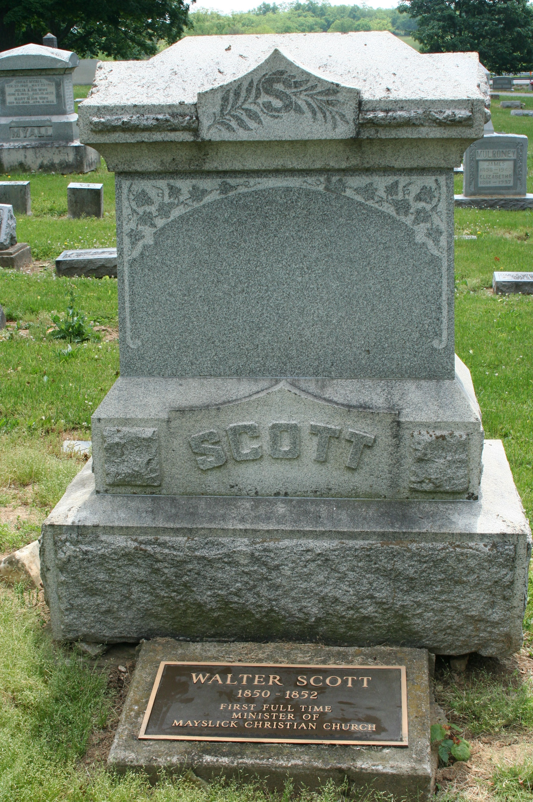
Walter Scott – the Gospel Restored
Later life of Walter Scott
April 16, 1861 – comes down with Typhoid Pneumonia
April 23, 1861 – Died at Mays Lick.
Campbell wrote, "Next to my father, he was my most cordial and indefatigable fellow laborer . . . I knew him well. I knew him long. I loved him much."

