Slide 1
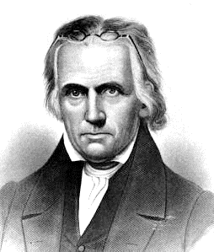
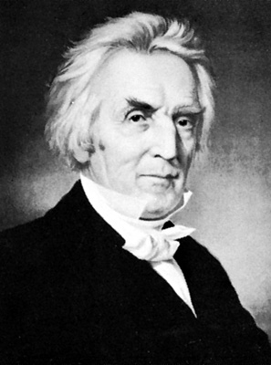
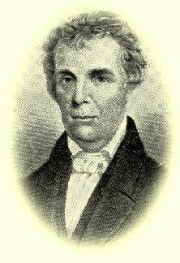
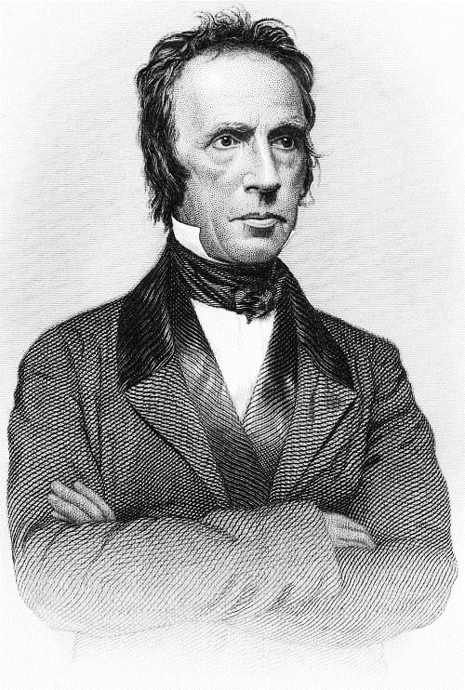
History of the Restoration Movement a study of the restoration ideal Lesson 4 What made America Ready for the Restoration Movement?
Kevin L. Ziegler, evangelist
South Side Church of Christ, Danville, IL
Restoration Plea Ministries

Slide 2
Outline of Class
Lesson 1 – What is meant by “Restoration Movement” and Why it Needs to be Taught
Lesson 2 – “Restoration” as a Biblical Principle
Lesson 3 – Restoration Movement before America
Lesson 4 – What made America Ready for the Restoration Movement?
Lesson 5 – Early Attempts at Restoration in America
Lesson 6 – Barton W. Stone – Consistent with the Word of God
Lesson 7 – Thomas Campbell – Speaking Where Scriptures Speak
Lesson 8 – Alexander Campbell – the Ancient Order of Things
Lesson 9 – Walter Scott – the Gospel Restored
Lesson 10 – Racoon John Smith – the Frontier Evangelist
Lesson 11 – Divisions within the Church
Lesson 12 – The Restoration Ideal in Today’s Church

Slide 3
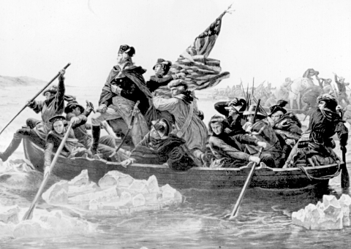
America Ready for the Restoration Movement
Americans were involved in three wars in the late 18th and early 19th centuries
French and Indian War (1754-1763)
Revolutionary War (1775-1783)
War of 1812 (1812-1814)

Slide 4
America Ready for the Restoration Movement
Revolutionary War (1775-1783)
Considered as a theological event, the Revolutionary War loosened the grip of Calvinism on the American mind.

Slide 5
Calvinism TULIP Theology
Total Depravity (Inherited Sin – hence totally depraved)
Unconditional Election (God predestines who will be saved)
Limited Atonement (Jesus died for only the elect)
Irresistible Grace (God forces one to “believe and be saved”)
Perseverance of the Saints (Once Saved – Always Saved)

Slide 6
America Ready for the Restoration Movement
Revolutionary War (1775-1783)
The idea of Total Depravity did not stand up well to the belief that men had the inherent capacity to shape their own destinies.

Slide 7
America Ready for the Restoration Movement
Revolutionary War (1775-1783)
The authoritarian spirit of the old, and sometimes reactionary, churches ran counter to the new spirit of intellectual freedom.
In religion, a European would do what he was told and sit down and be quiet – not so in America!

Slide 8
America Ready for the Restoration Movement
Revolutionary War (1775-1783)
Those who opposed Calvinism most strenuously often became Unitarians or abandoned Protestant Christianity entirely.
The ideas of the new nation had their effect on many believers who questioned the old orthodoxy, but continued to identify them­selves with the traditional churches. They wanted to do things an American way!

Slide 9
America Ready for the Restoration Movement
Moral Conditions after the Revolutionary War
The demoralizing effect of war.
Unbelief and immorality had infected the eastern colleges.
Skepticism of English deism and French atheism had made inroads to American thought.
Many of the traditional churches were characterized by creed-bound orthodoxy and low spirituality.

Slide 10
America Ready for the Restoration Movement
Moral Conditions after the Revolutionary War
Excessive use of alcohol was almost universal.
New liberty was often construed as license.
Galatians 5:13 – For you were called to freedom, brethren; only do not turn your freedom into an opportunity for the flesh, but through love serve one another.

Slide 11
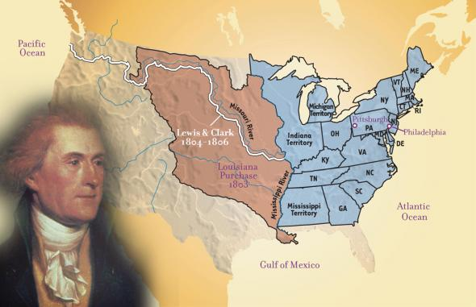
America Ready for the Restoration Movement
Louisiana Purchase (1803)

Slide 12
America Ready for the Restoration Movement
Moral Conditions after the Revolutionary War
Dislocation and disorientation inherent in the western movement produced a general decline in religion and morals.
Absence of organized churches in many areas.
Pressures of survival on the frontier.
Religious habits are easily broken in a fluid society.
Lack of education on the frontier moved religion from reason to emotion.

Slide 13
America Ready for the Restoration Movement
Religious Conditions after the Revolutionary War
American Protestantism was becoming "Americanized." This was a process beginning in the early 19th century.
Revivalism
Individualism (make Jesus your “personal Savior”)
Denominationalism (Americans believed that denominations were good and healthy for America. All part of the Lord’s church – just divided by name)

Slide 14
America Ready for the Restoration Movement
Religious Conditions after the Revolutionary War
America’s desire for religious liberty
Religious liberty was closely associated with political freedom. Establishment was on its way out in the colonies.
Religious liberty resulted in a break from the state­ church system.
Religious liberty often resulted in a break from the traditional European Protestant church bodies.

Slide 15
John Wesley Speaking to the Methodists
Organization of the Methodist Episcopal Church in America at Baltimore in 1784:
"As our American brethren are now totally disentangled both from the State and from the English hierarchy, we dare not entangle them again either with one or the other. They are now at full liberty simply to follow the Scriptures and the primitive church. And we judge it best that they should stand fast in the liberty wherewith God has so strangely (Wesley opposed the revolution) made them free."

Slide 16
America Ready for the Restoration Movement
Spiritual drought brought religious awakenings
The First Great Awakening (started about 1740)
George Whitefield
He preached over 81,000 Sermons!
Ruined by sin
Redeemed by Christ
Regenerated by the Holy Spirit
Jonathan Edwards
Sinners in the Hands of an Angry God

Slide 17
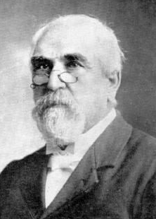
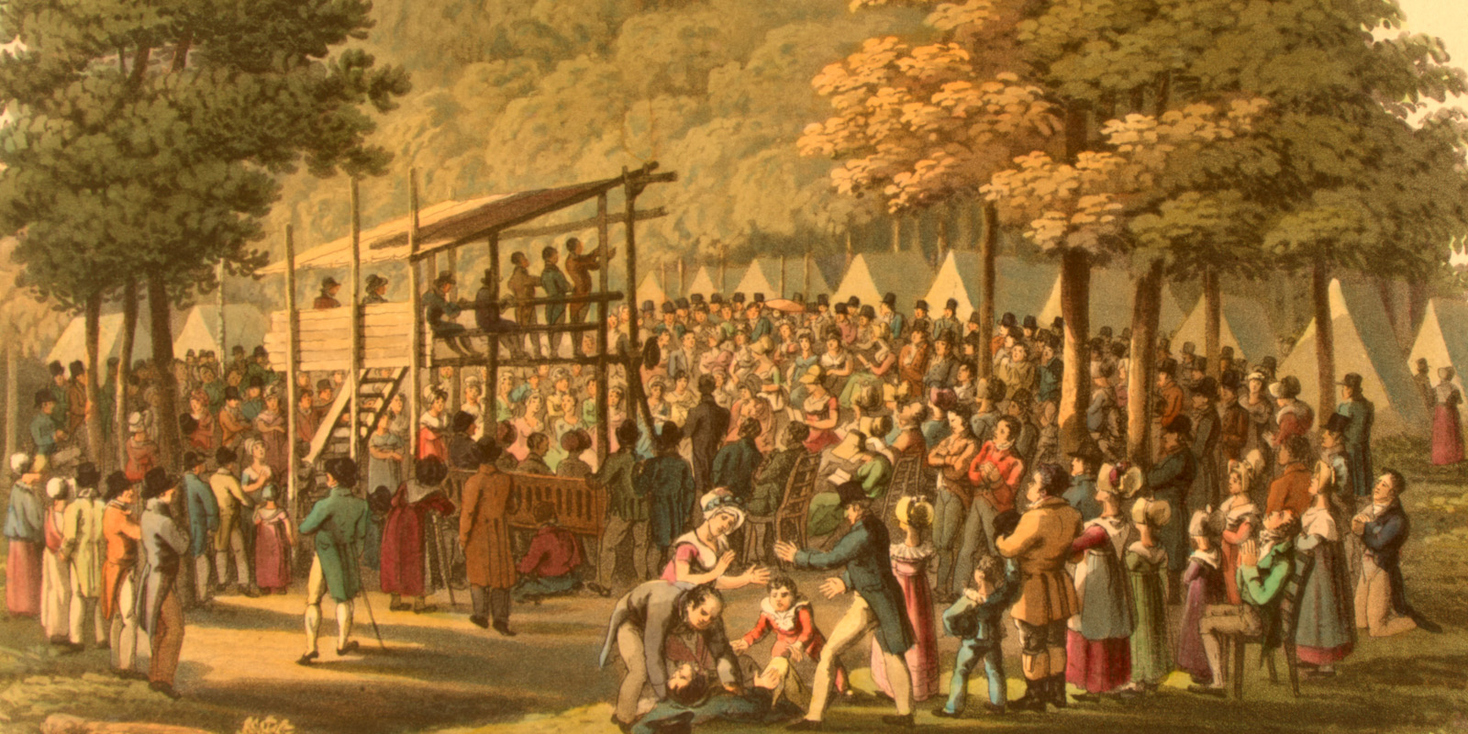
America Ready for the Restoration Movement
Spiritual drought brought religious awakenings
The Second Great Awakening (started about 1800)
James McGready
Timothy Dwight and the Yale revivals
Camp-meeting religion

Slide 18
America Ready for the Restoration Movement
The Doctrine of Conversion of the Religious awakenings
The dominance of Calvinism
Experience as evidence of salvation
Calvinism
Arminianism
Movement began early in the 17th century and asserted that God's sovereignty and man's free will are compatible.

Slide 19
Salvation and the Word of God Comparison of Great Awakenings and the NT
Great Awakenings | Experience | Faith | Reason | The Word
New Testament | The Word | Reason | Faith | Experience

